Slide 1
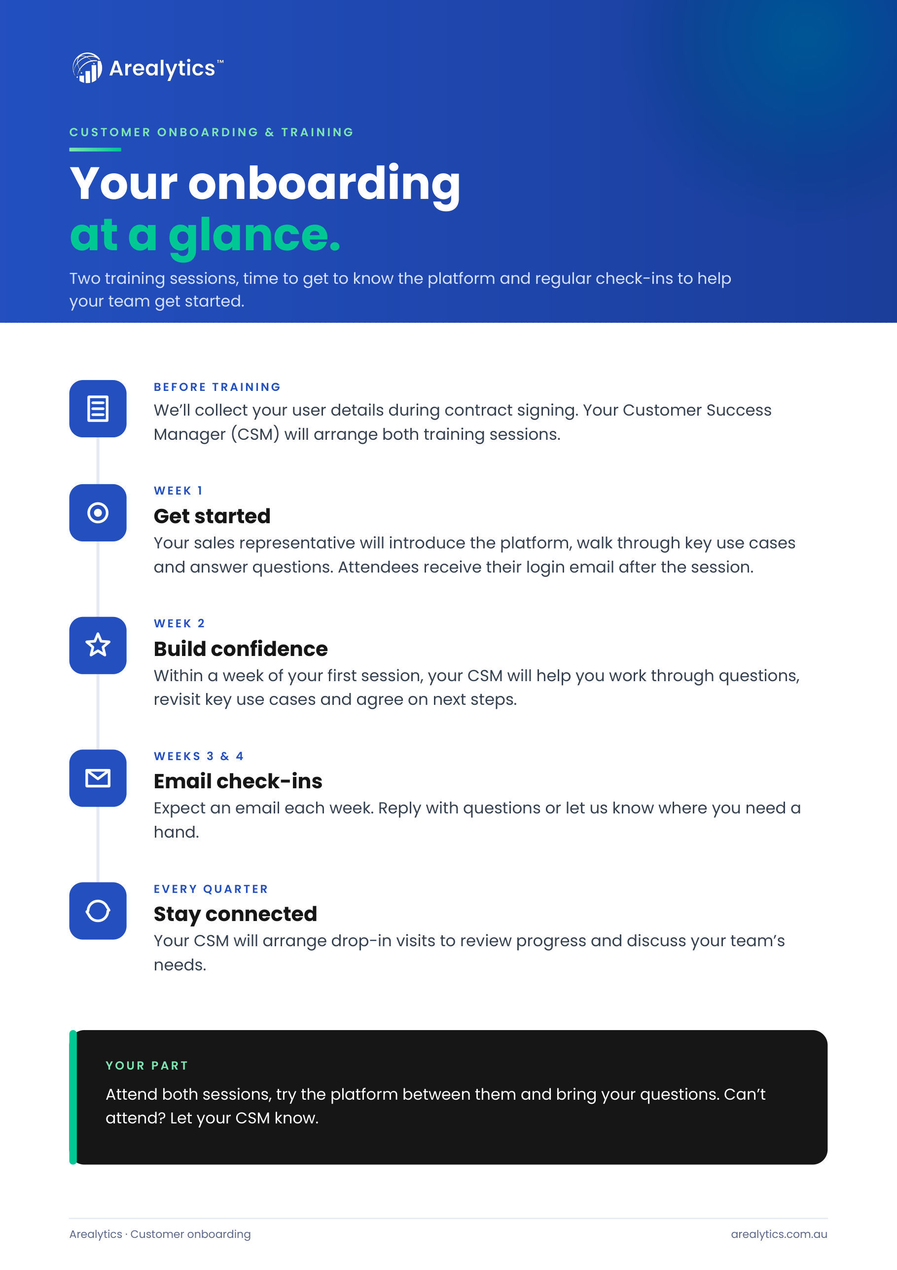
Notes:
Your onboarding at a glance — A4 portrait. Built by tools/build_onboarding_guide.py.

